Slide 1

Mobile Apps and Mobile Devices:
A First Look at Software and Hardware
Acknowledgment and Disclaimer: This presentation is supported in part by the National Science Foundation under Grants 1240841, 1225680, 1225719, 1225745, 1225976, and 1226216. Any opinions, findings, and conclusions or recommendations expressed in these materials are those of the authors and do not necessarily reflect the views of the National Science Foundation.
Notes:
*

Slide 2
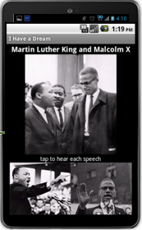
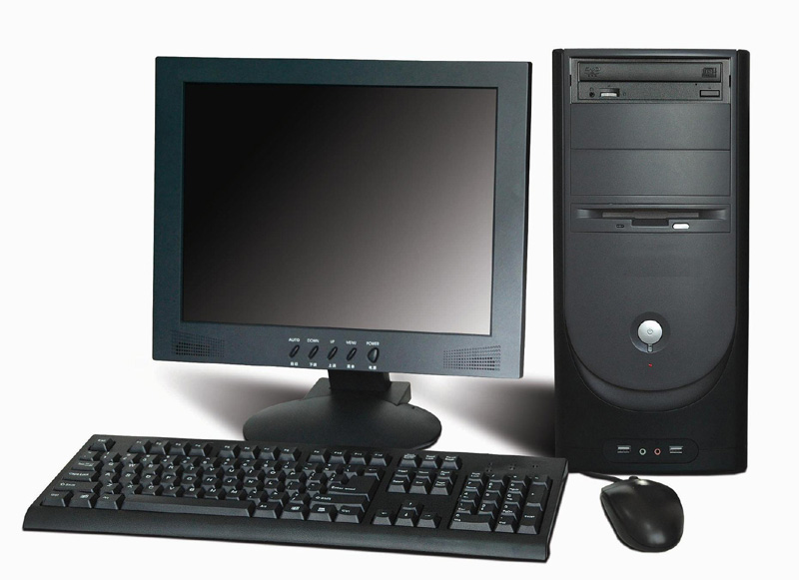
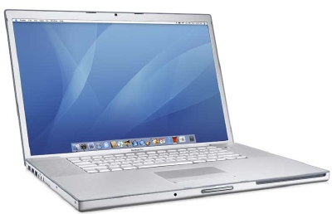
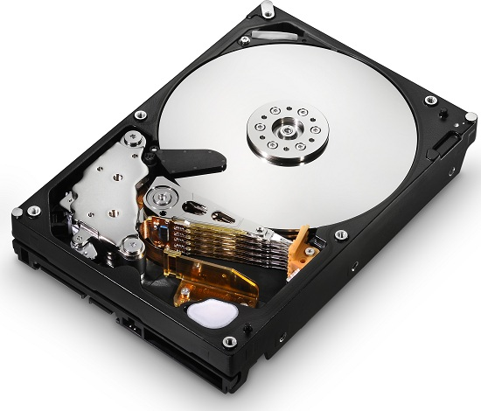
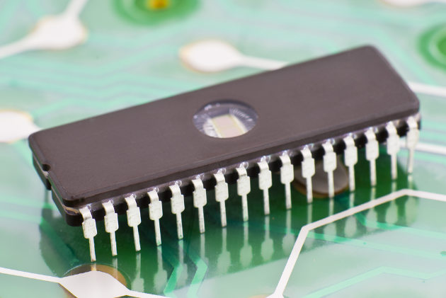
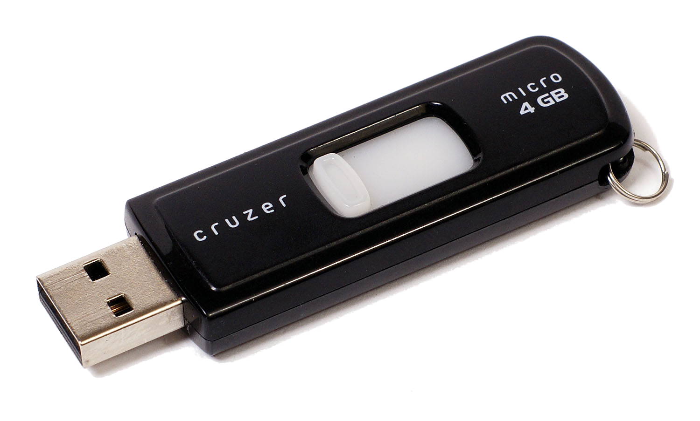
Hardware
Hardware -- the computer’s electronic and mechanical components.
Laptop
Smart phone
Desktop
Disk drive
Flash drive
Memory Chip

Slide 3
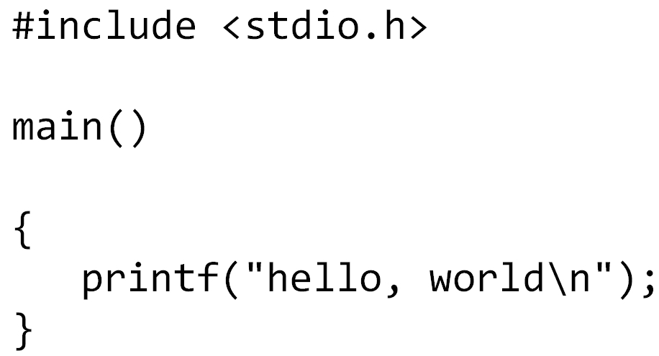
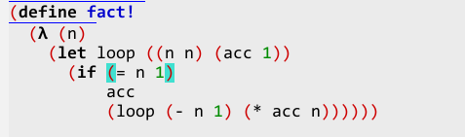
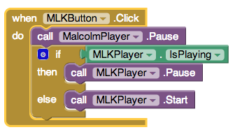
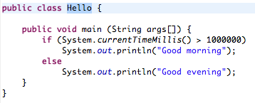

Software
Software -- the computer programs or code that controls the hardware.
C
Scheme
App Inventor
Python
Java

Slide 4
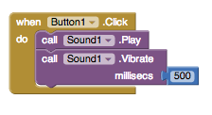
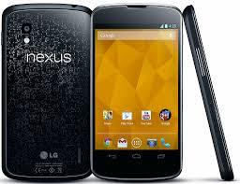
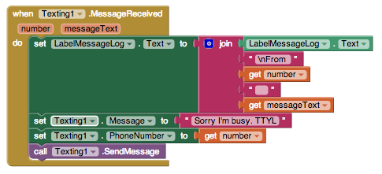
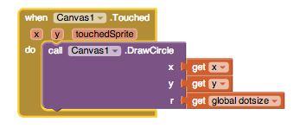
General Purpose Computers
A general purpose computer is a computer that can run any program (app) we give it.

Slide 5
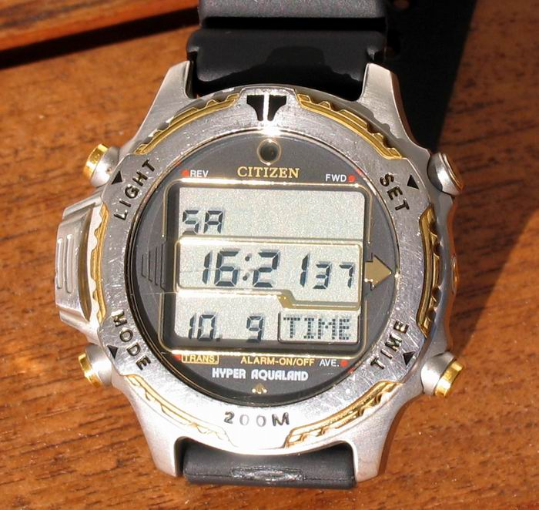
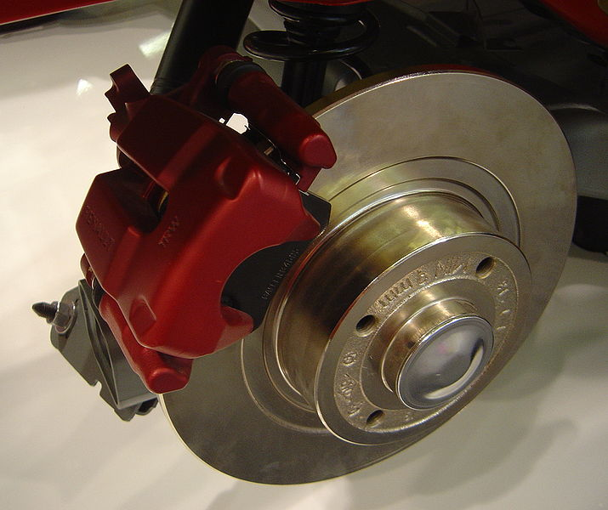
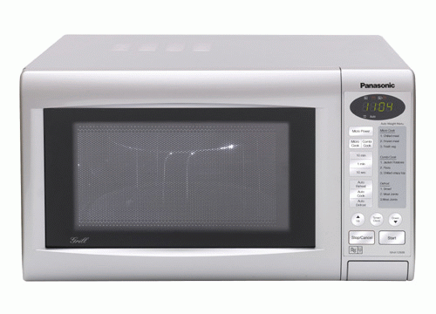
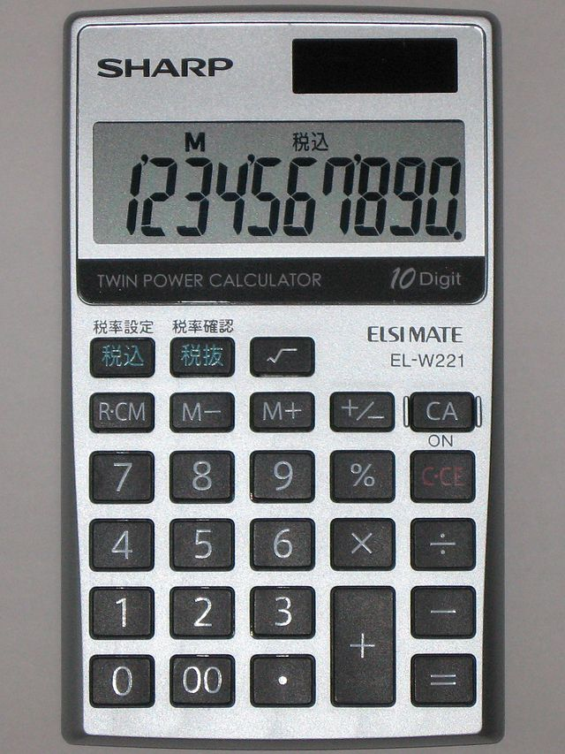
Special Purpose Computers
Special purpose computers have fixed programs that can’t be changed.
Watch program
Antilock Braking System
Microwave controller program
Calculator program

Slide 6


Computer Programmer
A programmer or coder is someone who designs and writes software.
That will be you, in a few weeks!
You

Slide 7
Hardware
Notes:
*

Slide 8
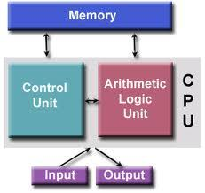
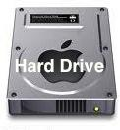
Main Hardware Components

Slide 9
Main Hardware Components
Random Access Memory (RAM) stores the computer’s programs and data temporarily while the power is on.

Slide 10
Main Hardware Components
Random Access Memory (RAM) stores the computer’s programs and data temporarily while the power is on.
Central Processing Unit (CPU) processes the program’s instructions and performs arithmetic and logic operations.

Slide 11
Main Hardware Components
Random Access Memory (RAM) stores the computer’s programs and data temporarily while the power is on.
Central Processing Unit (CPU) processes the program’s instructions and performs arithmetic and logic operations.
Storage devices (disk drives, flash drives, CDs) store data permanently even when the power is off.

Slide 12
Main Hardware Components
Random Access Memory (RAM) stores the computer’s programs and data temporarily while the power is on.
Central Processing Unit (CPU) processes the program’s instructions and performs arithmetic and logic operations.
I/O. Input devices (touchscreen, mic) transfer information into the computer’s memory.
Output devices (touchscreen, speaker) transfer information out of the memory.
Storage devices (disk drives, flash drives, CDs) store data permanently even when the power is off.

Slide 13
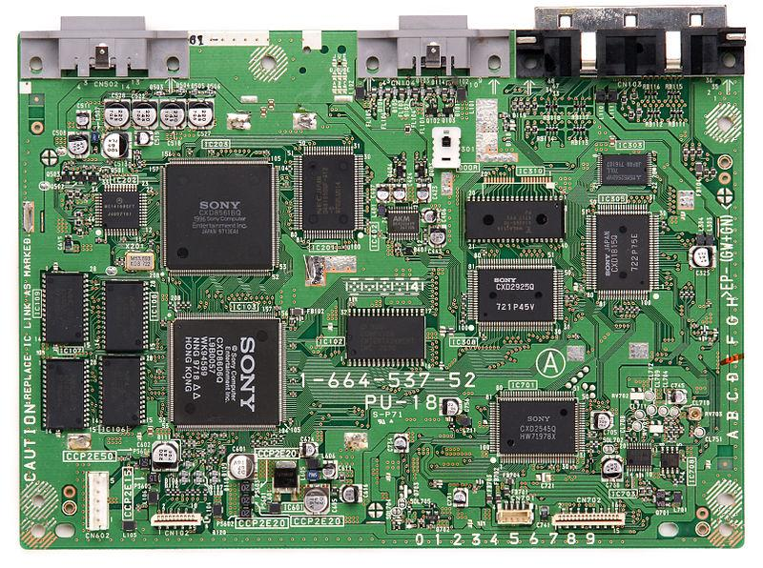
Motherboard and Chips
The motherboard is a pre-printed circuit board that houses all of the computer’s main electronic components.
Sony Playstation Motherboard

Slide 14
Motherboard and Chips
The motherboard is a pre-printed circuit board that houses all of the computer’s main electronic components.
A computer chip is another term for an integrated circuit (IC), a component that contains millions of electronic circuits. This chip is this computer’s CPU.
Sony Playstation Motherboard

Slide 15
Motherboard and Chips
The motherboard is a pre-printed circuit board that houses all of the computer’s main electronic components.
A computer chip is another term for an integrated circuit (IC), a component that contains millions of electronic circuits. This chip is this computer’s CPU.
Memory chips. This computer’s Random Access Memory (RAM).
I/O Connectors. I/O devices can be connected here.
Sony Playstation

Slide 16
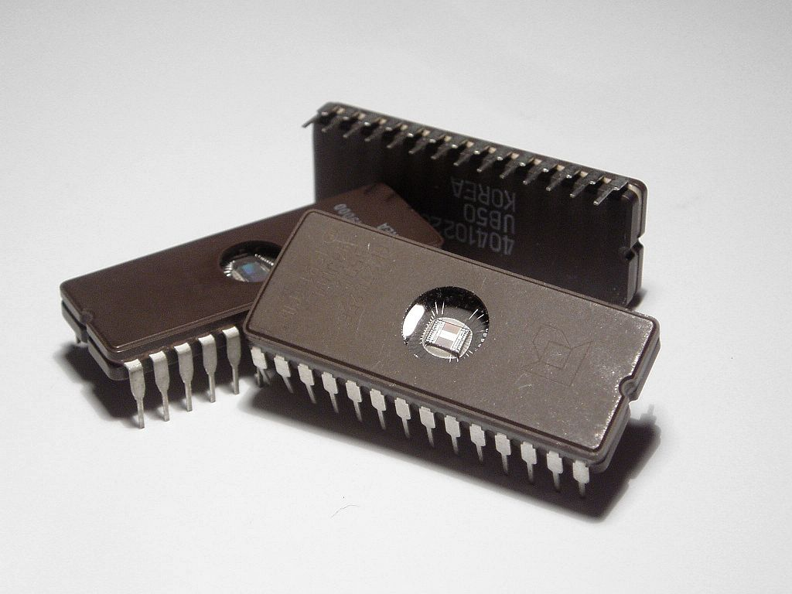
Chip: Integrated Circuit
Millions of electronic components (diodes, switches, gates, circuits) can be printed on a single chip.

Slide 17
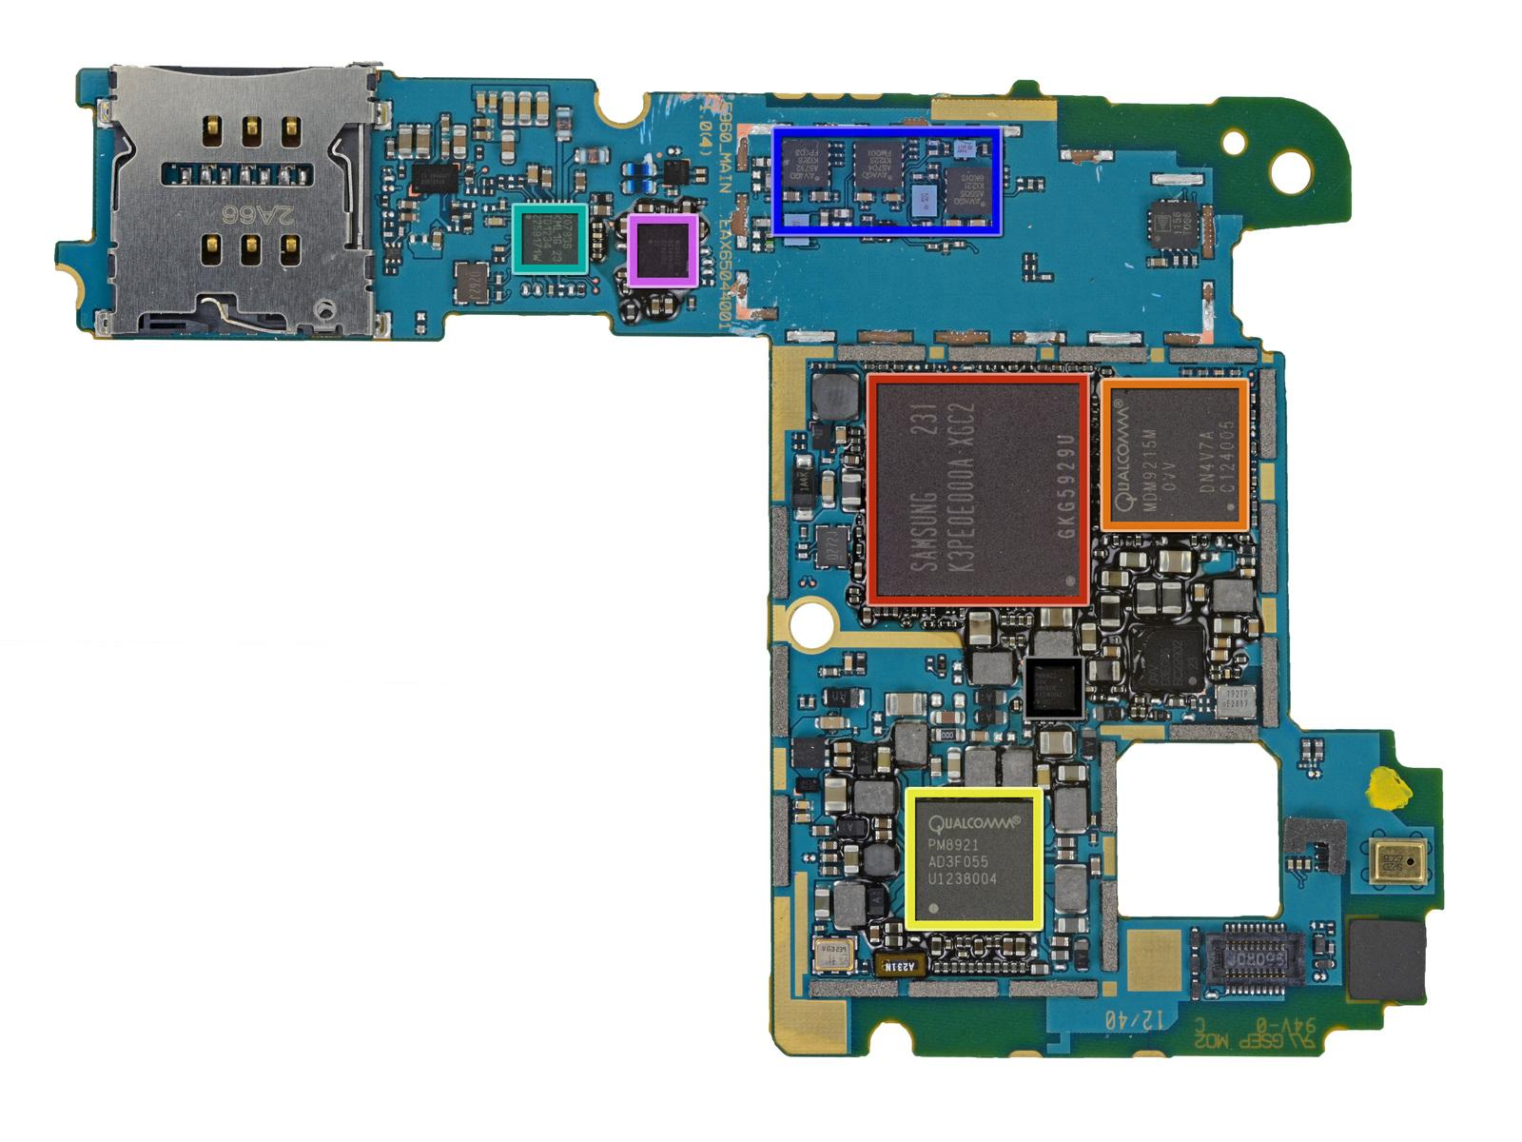
Nexus 4 Motherboard Back
2 Gb Samsung RAM memory chip
Snapdragon 1.4 GHz CPU underneath
Src: http://www.ifixit.com/Teardown/Nexus+4+Teardown/11781/3

Slide 18
Nexus 4 Motherboard Back
Qualcomm audio codec
2 Gb Samsung RAM memory chip
Snapdragon 1.4 GHz CPU underneath
Qualcomm modem
Src: http://www.ifixit.com/Teardown/Nexus+4+Teardown/11781/3

Slide 19
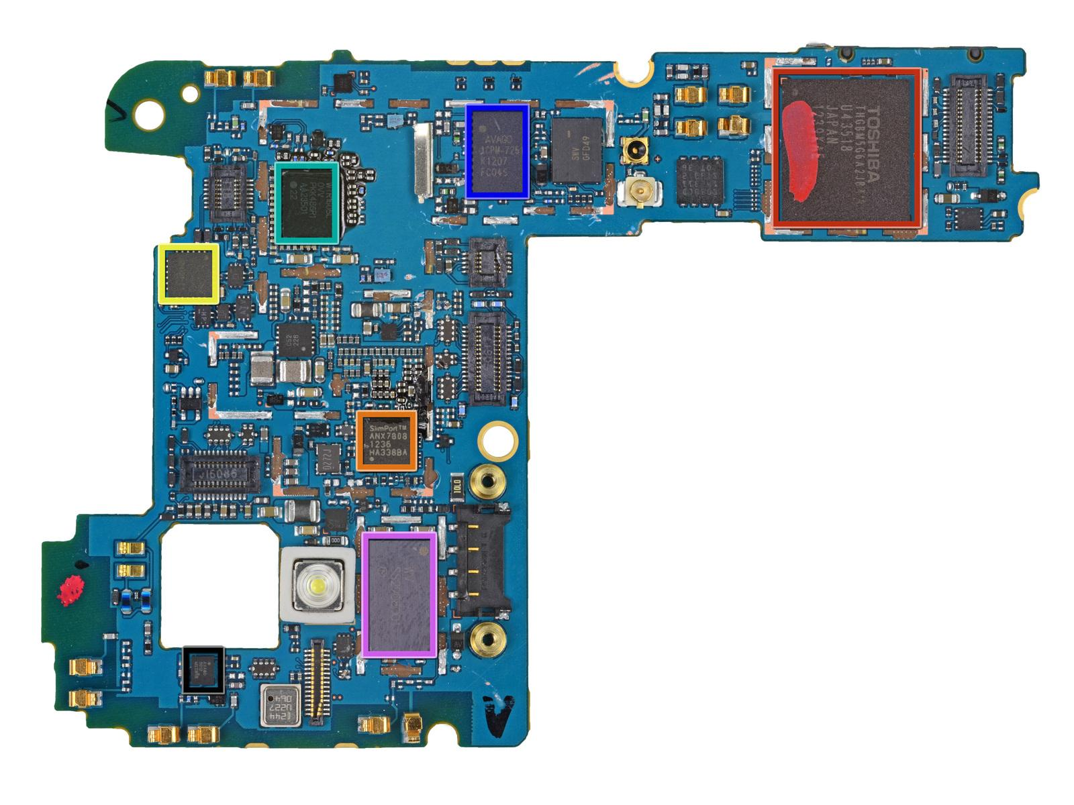
Nexus 4 Motherboard Front
8 Gb Flash drive – permanent storage
Qualcomm 4 Gb LTE phone chip
Accelerometer sensor
HDMI Output converter
Wifi/Bluetooth module
Src: http://www.ifixit.com/Teardown/Nexus+4+Teardown/11781/3

Slide 20
Software
Notes:
*

Slide 21
Software: Computer Programs
A computer program is a set of instructions that controls the computer.
App Inventor Program
Java Program

Slide 22
Software Interfaces
Software serves as an interface between us and our computers.
Human/Computer interface
App Inventor App
Software
Smart Phone
Hardware

Slide 23
Layers of Interfaces
Application Layer – I Have a Dream App
Hardware Layer – Nexus (Camera, touchscreen)

Slide 24

Layers of Interfaces
Application Layer – I Have a Dream App
OS/application interface
Operating System Layer – Android
App Loader
software
Camera controller
software
Touch screen controller
software
Hardware/software
interfaces
Hardware Layer – Nexus (Camera, touchscreen)

Slide 25
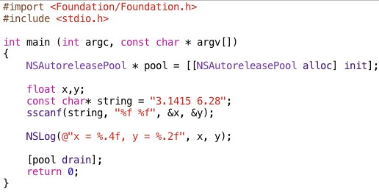

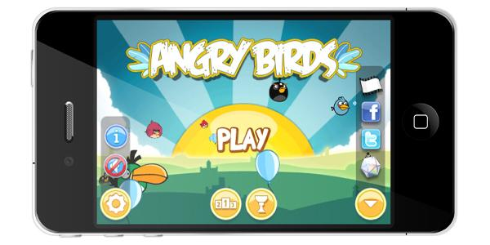
Layers of Interfaces
Application Layer – Angry Birds
OS/application interface
Operating System Layer – iOS
App Loader
software
Camera controller
software
Touch screen controller
software
Hardware/software
interfaces
Hardware Layer – iPhone (Camera, touchscreen)

Slide 26
Machine Language
Machine language – machine readable
00101100 1011011000111100
00110011 1110100011100010
00111001 1010100001100001

Slide 27
Machine Language
Machine language – machine readable
00101100 1011011000111100
00110011 1110100011100010
00111001 1010100001100001
Computers only understand their own machine language.

Slide 28
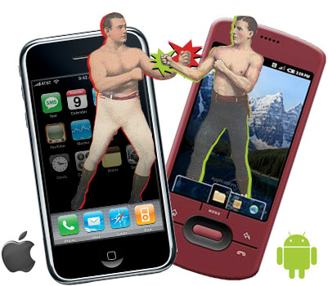
Machine Language
Machine language – machine readable
00101100 1011011000111100
00110011 1110100011100010
00111001 1010100001100001
Computers only understand their own machine language.

Slide 29

High- and Low-level Languages
High-level language - human readable
c = a + b;

Slide 30
High- and Low-level Languages
High-level language - human readable
c = a + b;
Machine language – machine readable
00101100 1011011000111100
00110011 1110100011100010
00111001 1010100001100001

Slide 31
High- and Low-level Languages
High-level language - human readable
c = a + b;
Translator software translates high level source code to low level binary code.
Machine language – machine readable
00101100 1011011000111100
00110011 1110100011100010
00111001 1010100001100001

Slide 32
Language Abstractions
App Inventor code -- a human-readable abstraction

Slide 33
Language Abstractions
App Inventor code -- a human-readable abstraction
Translation software
Binary code -- a machine-readable abstraction.
00111001 1010100001100001

Slide 34
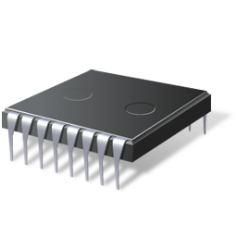
Language Abstractions
App Inventor code -- a human-readable abstraction
Translation software
Binary code -- a machine-readable abstraction.
00111001 1010100001100001
Binary Instruction Interpreter
CPU

Slide 35
Running An App
Notes:
*

Slide 36
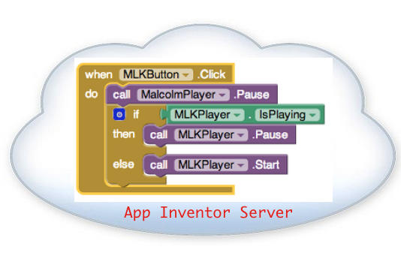
App Inventor : Translation
001010100100110101001000
Translate

Slide 37
App Inventor : Translation
“Connect to
Companion”
“Package”
001010100100110101001000
Translation

Slide 38
App Inventor : Connect to Companion
“Connect to Companion”
001010100100110101001000

Slide 39
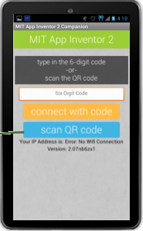
App Inventor : Connect to Companion
“Connect to Companion”
001010100100110101001000
Companion App
Interpreter

Slide 40
App Inventor : Connect to Companion
“Connect to Companion”
001010100100110101001000
Companion App
Interpreter
Android
OS

Slide 41

App Inventor : Connect to Companion
“Connect to Companion”
Reinterpret blocks
whenever something changes.
001010100100110101001000
Companion App
Interpreter
Android
OS

Slide 42
App Inventor : Connect to Companion
“Package”
001010100100110101001000

Slide 43
App Inventor : Package the App
“Package”
IHaveADream.apk
(Android machine code)
0010101001001101010010000101010100101001
001010100100110101001000
Android
OS

Slide 44
App Inventor : Package the App
“Package”
IHaveADream.apk
(Android machine code)
0010101001001101010010000101010100101001
001010100100110101001000
Barcode Scanner
Android
OS

Slide 45
Whew!
That was a lot of new concepts.
Notes:
*

Slide 46
Matching Activity
Match the technical terms with their definitions
Technical Term | Definition or description
Computer | The computer’s electronic and mechanical components
Program | A computer that has a fixed program (e.g. a calculator, a watch, a car's brakes)
Hardware | Houses the computer's main electronic components
Software | Stores the computer's programs and data temporarily while power is on
General purpose computer | A machine that processes information under the control of a program
Special purpose computer | An integrated circuit (IC) consisting of millions of tiny circuits
RAM (random access memory) | A computer that can run many different programs (e.g. a smartphone)
Central Processing Unit (CPU) | The hardware that carries out the instructions of a computer program.
Motherboard | The programs that control the computer
Machine language | A programming language that is human readable (App Inventor) and provides the programmer with easy to understand abstractions
High level language | A programming language that is directly readable by the computer’s CPU.
Chip | A sequence of instructions that controls the computer
Notes:
*

